Slide 1
MongoDB Vs SQL Databases

Slide 2
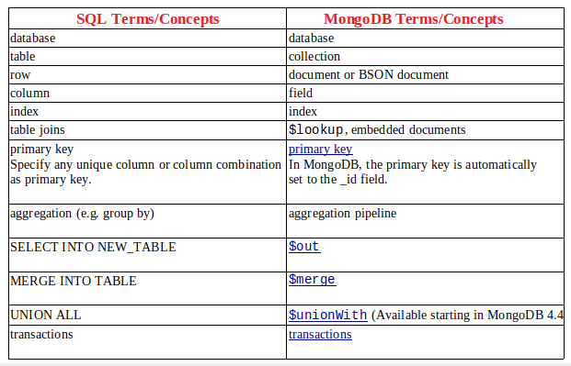
MongoDB Vs SQL Databases
The following table presents the various SQL terminology and concepts and the corresponding MongoDB terminology and concepts.

Slide 3
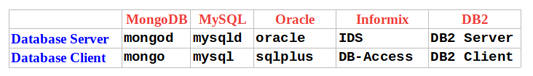
MongoDB Vs SQL Databases
The following table presents some database executables and the corresponding MongoDB executables. This table is not meant to be exhaustive.

Slide 4
MongoDB Vs SQL Databases
Create and Alter
The following table presents the various SQL statements related to table-level actions and the corresponding MongoDB statements.
SQL Schema Statements | MongoDB Schema Statements
CREATE TABLE people ( id INT NOT NULL AUTO_INCREMENT, user_id Varchar(30), age Number, status char(1), PRIMARY KEY (id) ) | Implicitly created on first insertOne() or insertMany() operation. The primary key _id is automatically added if _id field is not specified. db.people.insertOne( { user_id: "abc123", age: 55, status: "A" } ) you can also explicitly create a collection: db.createCollection("people")

Slide 5
MongoDB Vs SQL Databases
Create and Alter
The following table presents the various SQL statements related to table-level actions and the corresponding MongoDB statements.
SQL Schema Statements | MongoDB Schema Statements
ALTER TABLE people ADD join_date DATETIME | Collections do not describe or enforce the structure of its documents; i.e. there is no structural alteration at the collection level. However, at the document level, updateMany() operations can add fields to existing documents using the $set operator. db.people.updateMany( { }, { $set: { join_date: new Date() } } )

Slide 6
MongoDB Vs SQL Databases
Create and Alter
The following table presents the various SQL statements related to table-level actions and the corresponding MongoDB statements.
SQL Schema Statements | MongoDB Schema Statements
ALTER TABLE people DROP COLUMN join_date | Collections do not describe or enforce the structure of its documents; i.e. there is no structural alteration at the collection level. However, at the document level, updateMany() operations can remove fields from documents using the $unset operator. db.people.updateMany( { }, { $unset: { "join_date": "" } } )

Slide 7
MongoDB Vs SQL Databases
Create and Alter
The following table presents the various SQL statements related to table-level actions and the corresponding MongoDB statements.
SQL Schema Statements | MongoDB Schema Statements
CREATE INDEX idx_user_id_asc ON people(user_id) | db.people.createIndex( { user_id: 1 } )
CREATE INDEX idx_user_id_asc_age_desc ON people(user_id, age DESC) | db.people.createIndex( { user_id: 1, age: -1 } )
DROP TABLE people | db.people.drop()

Slide 8
MongoDB Vs SQL Databases
Insert Operations
The following table presents the various SQL statements related to inserting records into tables and the corresponding MongoDB statements.
SQL Schema Statements | MongoDB Schema Statements
INSERT INTO people (user_id,age, status) VALUES ("bcd001",45,"A") | db.people.insertOne( { user_id: "bcd001", age: 45, status: "A" } )

Slide 9
MongoDB Vs SQL Databases
Select Operations
The following table presents the various SQL statements related to reading records from tables and the corresponding MongoDB statements.
The find() method always includes the _id field in the returned documents unless specifically excluded through projection.
SQL Schema Statements | MongoDB Schema Statements
SELECT * FROM people | db.people.find()
SELECT id, user_id, status FROM people | db.people.find( { }, { user_id: 1, status: 1 } )
SELECT user_id, status FROM people | db.people.find( { }, { user_id: 1, status: 1, _id: 0 } )

Slide 10
MongoDB Vs SQL Databases
Select Operations
SQL Schema Statements | MongoDB Schema Statements
SELECT * FROM people WHERE status = "A" | db.people.find( { status: "A" } )
SELECT user_id, status FROM people WHERE status = "A" | db.people.find( { status: "A" }, { user_id: 1, status: 1, _id: 0 } )
SELECT * FROM people WHERE status != "A" | db.people.find( { status: { $ne: "A" } } )
SELECT * FROM people WHERE status = "A" AND age = 50 | db.people.find( { status: "A", age: 50 } )
SELECT * FROM people WHERE status = "A" OR age = 50 | db.people.find( { $or: [ { status: "A" } , { age: 50 } ] } )

Slide 11
MongoDB Vs SQL Databases
Select Operations
SQL Schema Statements | MongoDB Schema Statements
SELECT * FROM people WHERE age > 25 | db.people.find( { age: { $gt: 25 } } )
SELECT * FROM people WHERE age < 25 | db.people.find( { age: { $lt: 25 } } )
SELECT * FROM people WHERE age > 25 AND age <= 50 | db.people.find( { age: { $gt: 25, $lte: 50 } } )
SELECT * FROM people WHERE user_id like "%bc%" | db.people.find( { user_id: /bc/ } ) -or- db.people.find( { user_id: { $regex: /bc/ } } )

Slide 12
MongoDB Vs SQL Databases
Select Operations
SQL Schema Statements | MongoDB Schema Statements
SELECT * FROM people WHERE user_id like "bc%" | db.people.find( { user_id: /^bc/ } ) -or- db.people.find( { user_id: { $regex: /^bc/ } } )
SELECT * FROM people WHERE status = "A" ORDER BY user_id ASC | db.people.find( { status: "A" } ).sort( { user_id: 1 } )
SELECT * FROM people WHERE status = "A" ORDER BY user_id DESC | db.people.find( { status: "A" } ).sort( { user_id: -1 } )
SELECT COUNT(*) FROM people | db.people.count() or db.people.find().count()

Slide 13
MongoDB Vs SQL Databases
Select Operations
SQL Schema Statements | MongoDB Schema Statements
SELECT COUNT(user_id) FROM people | db.people.count( { user_id: { $exists: true } } ) or db.people.find( { user_id: { $exists: true } } ).count()
SELECT COUNT(*) FROM people WHERE age > 30 | db.people.count( { age: { $gt: 30 } } ) or db.people.find( { age: { $gt: 30 } } ).count()
SELECT DISTINCT(status) FROM people | db.people.aggregate( [ { $group : { _id : "$status" } } ] ) or, for distinct value sets that do not exceed the BSON size limit db.people.distinct( "status" )

Slide 14
MongoDB Vs SQL Databases
Select Operations
SQL Schema Statements | MongoDB Schema Statements
SELECT * FROM people LIMIT 1 | db.people.findOne() or db.people.find().limit(1)
SELECT * FROM people LIMIT 5 SKIP 10 | db.people.find().limit(5).skip(10)
EXPLAIN SELECT * FROM people WHERE status = "A" | db.people.find( { status: "A" } ).explain()

Slide 15
MongoDB Vs SQL Databases
Update Operations
The following table presents the various SQL statements related to updating existing records in tables and the corresponding MongoDB statements.
SQL Schema Statements | MongoDB Schema Statements
UPDATE people SET status = "C" WHERE age > 25 | db.people.updateMany( { age: { $gt: 25 } }, { $set: { status: "C" } } )
UPDATE people SET age = age + 3 WHERE status = "A" | db.people.updateMany( { status: "A" } , { $inc: { age: 3 } } )

Slide 16
MongoDB Vs SQL Databases
Delete Operations
The following table presents the various SQL statements related to updating existing records in tables and the corresponding MongoDB statements.
SQL Schema Statements | MongoDB Schema Statements
DELETE FROM people WHERE status = "D" | db.people.deleteMany( { status: "D" } )
DELETE FROM people | db.people.deleteMany({})

Slide 17
MongoDB Vs SQL Databases
Aggregation pipeline.
The following table provides an overview of common SQL aggregation terms, functions, and concepts and the corresponding MongoDB aggregation operators.
SQL Schema Statements | MongoDB Schema Statements
WHERE | database
GROUP BY | collection
HAVING | document or BSON document
SELECT | field
ORDER BY | index
LIMIT | $lookup, embedded documents
SUM() | primary key In MongoDB, the primary key is automatically set to the _id field.
COUNT() | aggregation pipeline
join | $out
SELECT INTO NEW_TABLE | $merge
MERGE INTO TABLE | $unionWith
UNION ALL | transactions

Slide 18
Aggregation pipeline
Documents enter a multi-stage pipeline that transforms the documents into an aggregated result.
db.orders.aggregate([
{ $match: { status: "A" } },
{ $group: { _id: "$cust_id", total: { $sum: "$amount" } } }
])
First Stage: The $match stage filters the documents by the status field and passes to the next stage those documents that have status equal to "A".
Second Stage: The $group stage groups the documents by the cust_id field to calculate the sum of the amount for each unique cust_id.

Slide 19
Map-Reduce
MongoDB also provides map-reduce operations to perform aggregation. Map-reduce uses custom JavaScript functions to perform the map and reduce operations, as well as the optional finalize operation.
In MongoDB, map-reduce operations use custom JavaScript functions to map, or associate, values to a key. If a key has multiple values mapped to it, the operation reduces the values for the key to a single object.
map is a javascript function that maps a value with a key and emits a key-value pair
reduce is a javascript function that reduces or groups all the documents having the same key

Slide 20
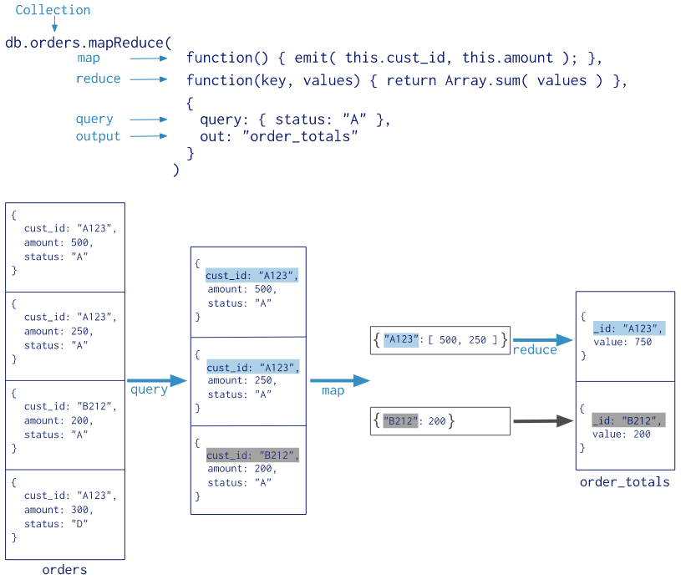

Slide 21
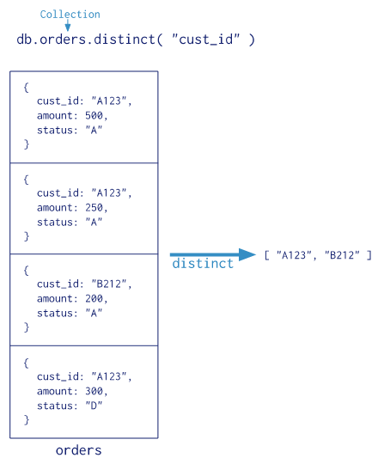
Single Purpose Aggregation Operations
MongoDB provides db.collection.estimatedDocumentCount(), db.collection.count() and db.collection.distinct().
All of these operations aggregate documents from
a single collection.
these operations provide simple access to
common aggregation processes, they lack the flexibility
and capabilities of the aggregation pipeline and map-reduce.

Slide 22
MongoDB Vs SQL Databases
The following table presents a quick reference of SQL aggregation statements and the corresponding MongoDB statements. The examples in the table assume the following conditions:
The SQL examples assume two tables, orders and order_lineitem that join by the order_lineitem.order_id and the orders.id columns.
The MongoDB examples assume one collection orders that contain documents of the following prototype:
{
cust_id: "abc123",
ord_date: ISODate("2012-11-02T17:04:11.102Z"),
status: 'A',
price: 50,
items: [ { sku: "xxx", qty: 25, price: 1 },
{ sku: "yyy", qty: 25, price: 1 } ]
}

Slide 23
MongoDB Vs SQL Databases
The following table presents a quick reference of SQL aggregation statements and the corresponding MongoDB statements.
SQL Statements | MongoDB Statements | Description
SELECT COUNT(*) AS count FROM orders | db.orders.aggregate( [ { $group: { _id: null, count: { $sum: 1 } } } ] ) | Count all records from orders
SELECT SUM(price) AS total FROM orders | db.orders.aggregate( [ { $group: { _id: null, total: { $sum: "$price" } } } ] ) | Sum the price field from orders

Slide 24
MongoDB Vs SQL Databases
SQL Statements | MongoDB Statements | Description
SELECT cust_id, SUM(price) AS total FROM orders GROUP BY cust_id | db.orders.aggregate( [ { $group: { _id: "$cust_id", total: { $sum: "$price" } } } ] ) | For each unique cust_id, sum the price field.
SELECT cust_id, SUM(price) AS total FROM orders GROUP BY cust_id ORDER BY total | db.orders.aggregate( [ { $group: { _id: "$cust_id", total: { $sum: "$price" } } }, { $sort: { total: 1 } } ] ) | For each unique cust_id, sum the price field, results sorted by sum.

Slide 25
MongoDB Vs SQL Databases
SQL Statements | MongoDB Statements | Description
SELECT cust_id, ord_date, SUM(price) AS total FROM orders GROUP BY cust_id, ord_date | db.orders.aggregate( [ { $group: { _id: { cust_id: "$cust_id", ord_date: { $dateToString: { format: "%Y-%m-%d", date: "$ord_date" }} }, total: { $sum: "$price" } } } ] ) | For each unique cust_id, ord_date grouping, sum the price field. Excludes the time portion of the date.
SELECT cust_id, count(*) FROM orders GROUP BY cust_id HAVING count(*) > 1 | db.orders.aggregate( [ { $group: { _id: "$cust_id", count: { $sum: 1 } } }, { $match: { count: { $gt: 1 } } } ] ) | For cust_id with multiple records, return the cust_id and the corresponding record count.

Slide 26
MongoDB Vs SQL Databases
SQL Statements | MongoDB Statements | Description
SELECT cust_id, ord_date, SUM(price) AS total FROM orders GROUP BY cust_id, ord_date HAVING total > 250 | db.orders.aggregate( [ { $group: { _id: { cust_id: "$cust_id", ord_date: { $dateToString: { format: "%Y-%m-%d", date: "$ord_date" }} }, total: { $sum: "$price" } } }, { $match: { total: { $gt: 250 } } } ] ) | For each unique cust_id, ord_date grouping, sum the price field and return only where the sum is greater than 250. Excludes the time portion of the date.
SELECT cust_id, SUM(price) as total FROM orders WHERE status = 'A' GROUP BY cust_id | db.orders.aggregate( [ { $match: { status: 'A' } }, { $group: { _id: "$cust_id", total: { $sum: "$price" } } } ] ) | For each unique cust_id with status A, sum the price field.

Slide 27
MongoDB Vs SQL Databases
SQL Statements | MongoDB Statements | Description
SELECT cust_id, SUM(price) as total FROM orders WHERE status = 'A' GROUP BY cust_id HAVING total > 250 | db.orders.aggregate( [ { $match: { status: 'A' } }, { $group: { _id: "$cust_id", total: { $sum: "$price" } } }, { $match: { total: { $gt: 250 } } } ] ) | For each unique cust_id with status A, sum the price field and return only where the sum is greater than 250.
SELECT cust_id, SUM(li.qty) as qty FROM orders o, order_lineitem li WHERE li.order_id = o.id GROUP BY cust_id | db.orders.aggregate( [ { $unwind: "$items" }, { $group: { _id: "$cust_id", qty: { $sum: "$items.qty" } } } ] ) | For each unique cust_id, sum the corresponding line item qty fields associated with the orders.

Slide 28
MongoDB Vs SQL Databases
SQL Statements | MongoDB Statements | Description
SELECT COUNT(*) FROM (SELECT cust_id, ord_date FROM orders GROUP BY cust_id, ord_date) as DerivedTable | db.orders.aggregate( [ { $group: { _id: { cust_id: "$cust_id", ord_date: { $dateToString: { format: "%Y-%m-%d", date: "$ord_date" }} } } }, { $group: { _id: null, count: { $sum: 1 } } } ] ) | Count the number of distinct cust_id, ord_date groupings. Excludes the time portion of the date.

Slide 29
References
https://docs.mongodb.com.

